Slide 1
Extracting data
Creating a data extraction project and running our first extraction and linkage

Slide 2
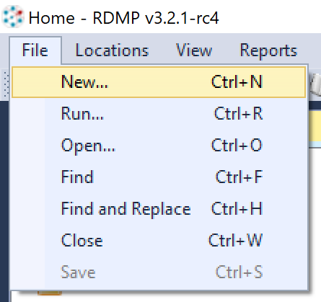
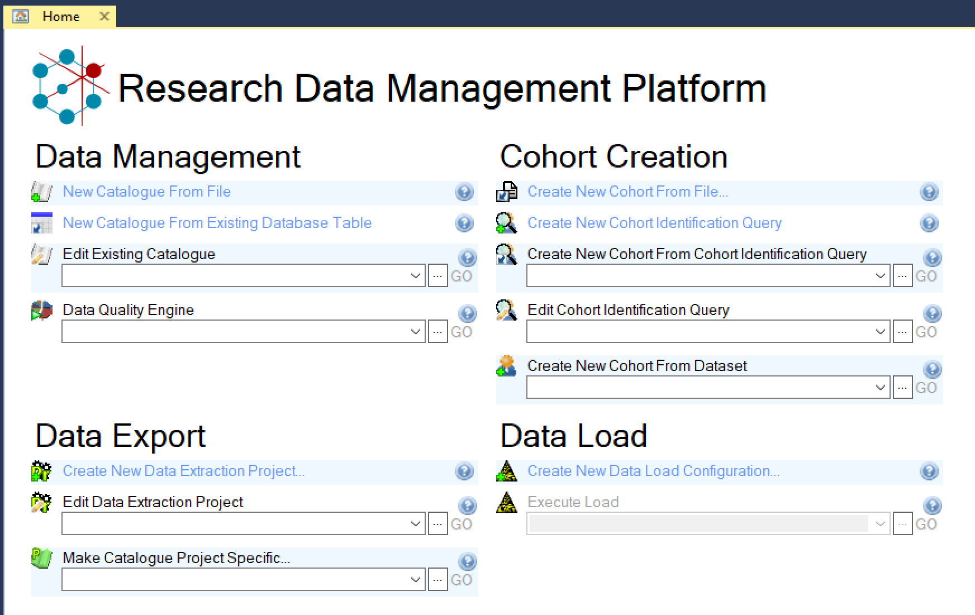

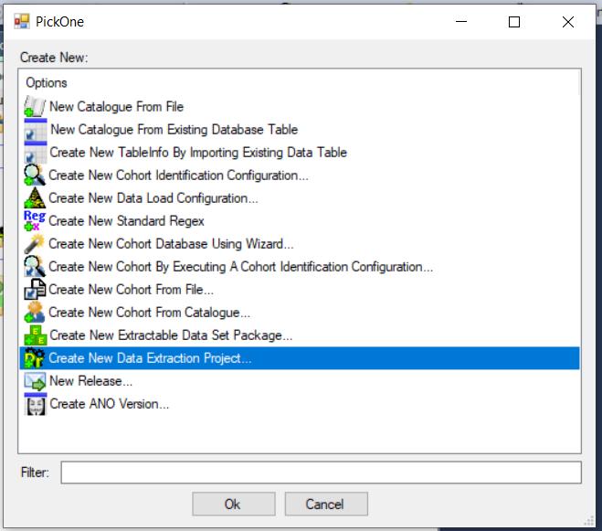
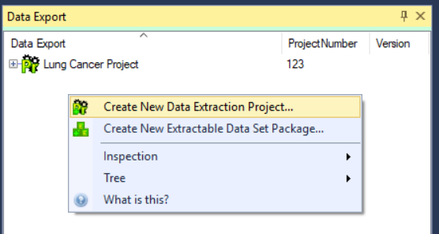
How to create a new Data Project
From the Home Screen:
From the File menu:
From the Data Export context menu (right click on empty space):
Notes:
All the 3 methods above take you to the Wizard, so it’s really just a matter of preferences and of what people remember.

Slide 3
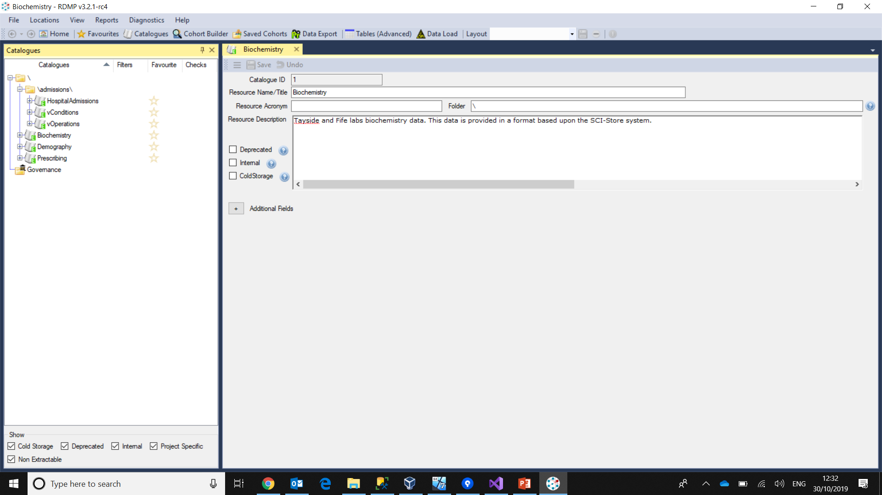
At a glance
Menu area
Collection area: list of all elements of a particular type
Working area: main activities happen here (editing a Catalogue, running a cohort builder, etc.)

Slide 4
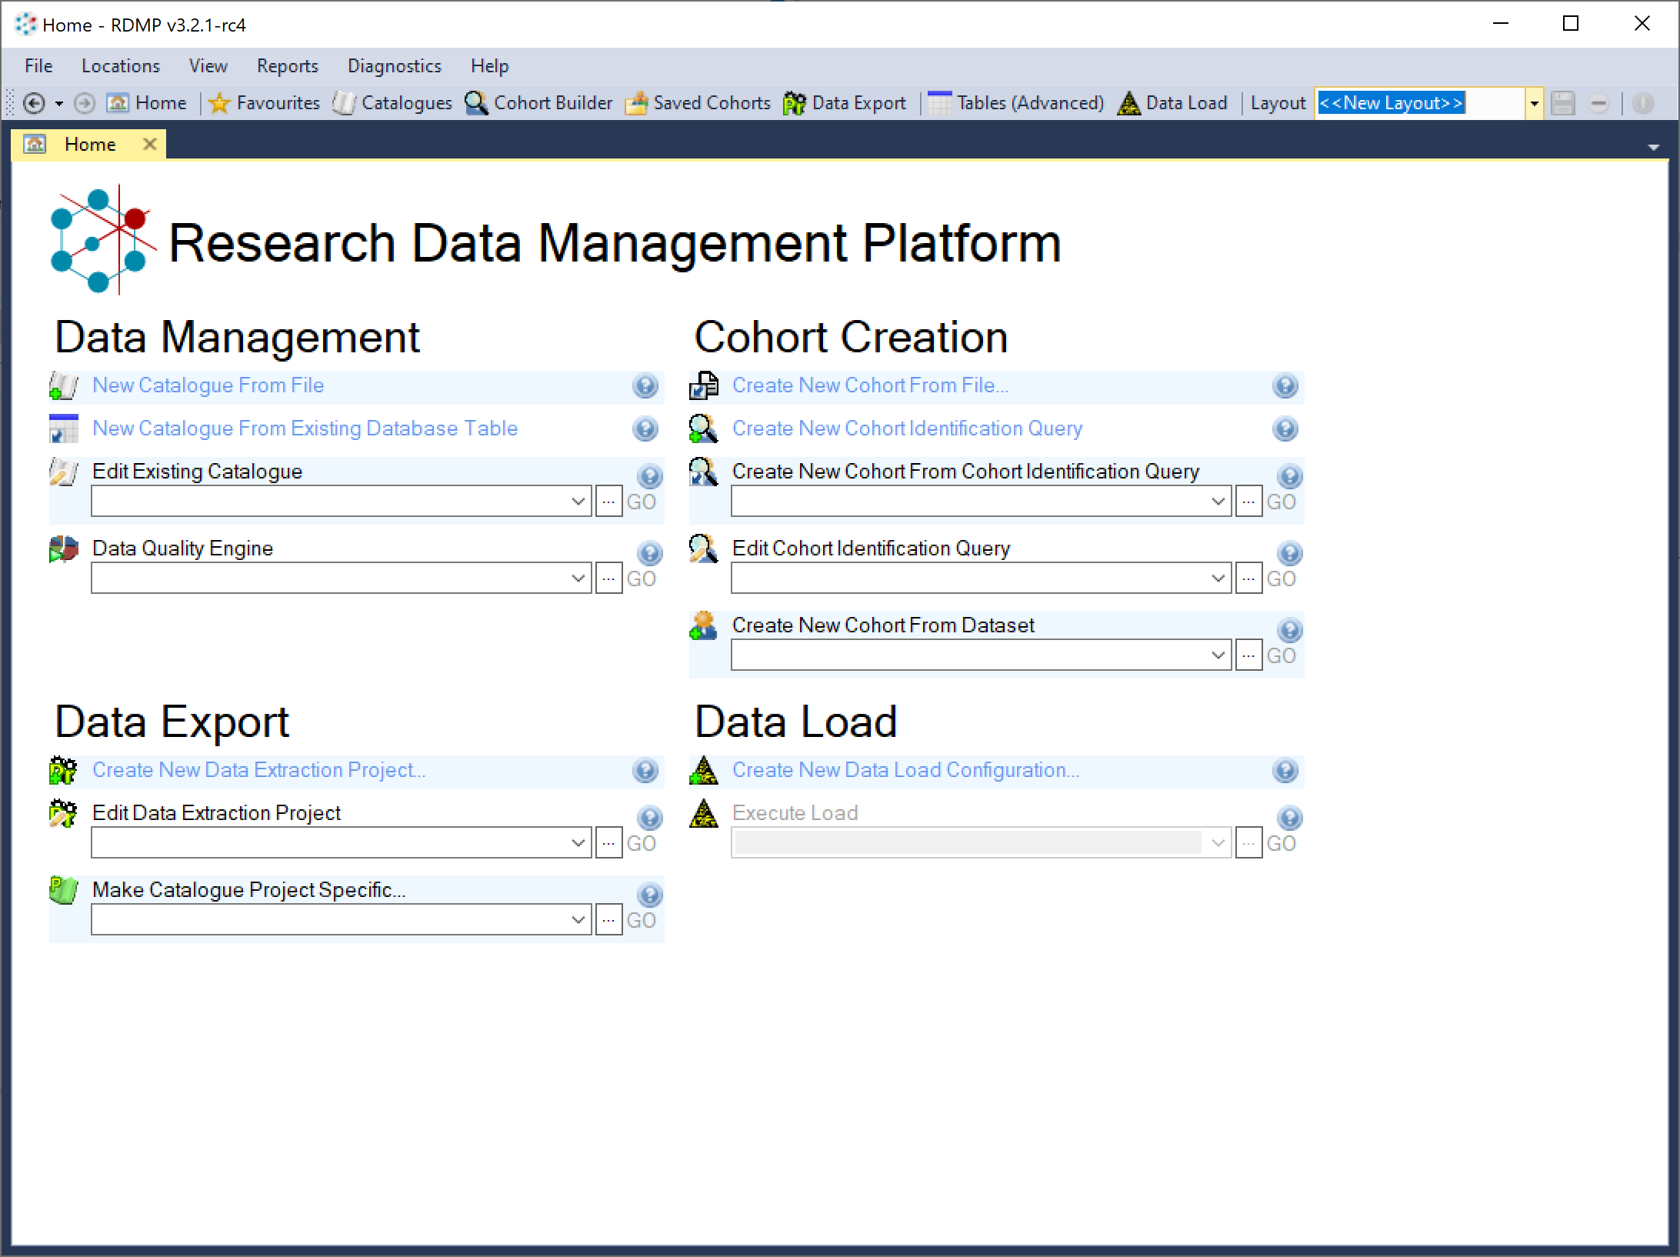
Top menu
Home button
More advanced functions
Save and retrieve windows layout
Main functions

Slide 5
Home
Notes:
Quick access to some of the more used functionality of RDMP. Always good to start here or go back here when starting new work

Slide 6
Help!
You can hover on top of almost every item to receive a brief help of the function performed
Where you see a help button, clicking it will show some more information
Hover here for more help
Hover or click here for more help

Slide 7
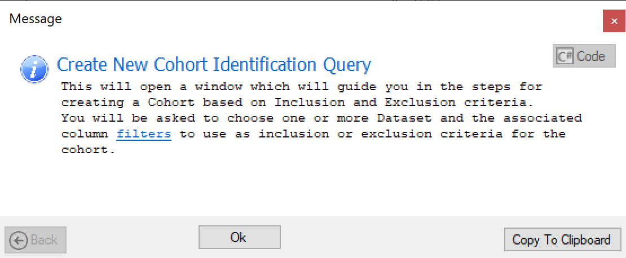
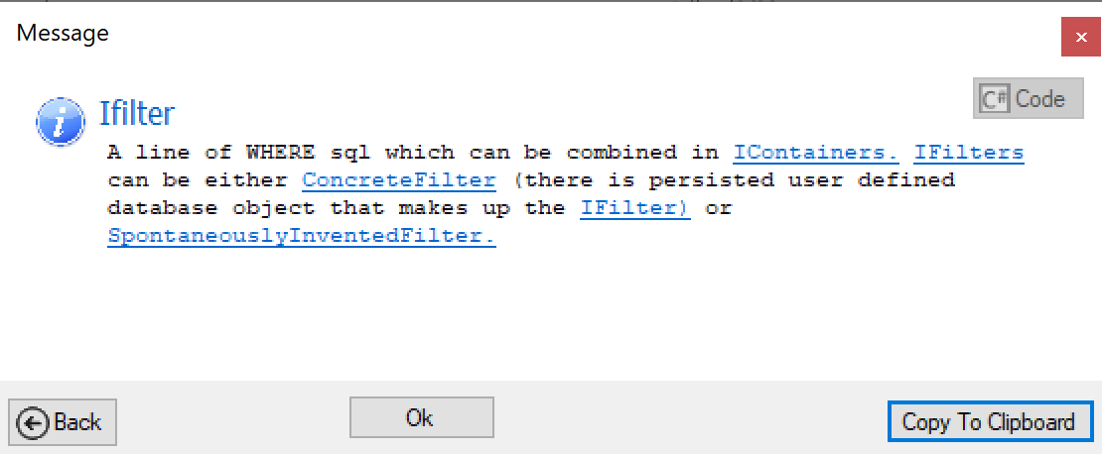
Help can be navigated
Click here for more help
Continue browsing…
… or go back

Slide 8
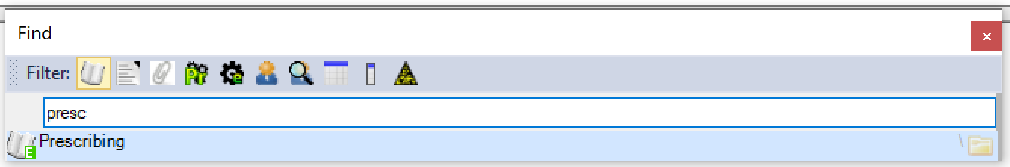
Find your work
Filter the object type(s) you want to find…
File -> Find…
File -> Open…
Ctrl-F
…start typing
Click or press Enter to open

Slide 9
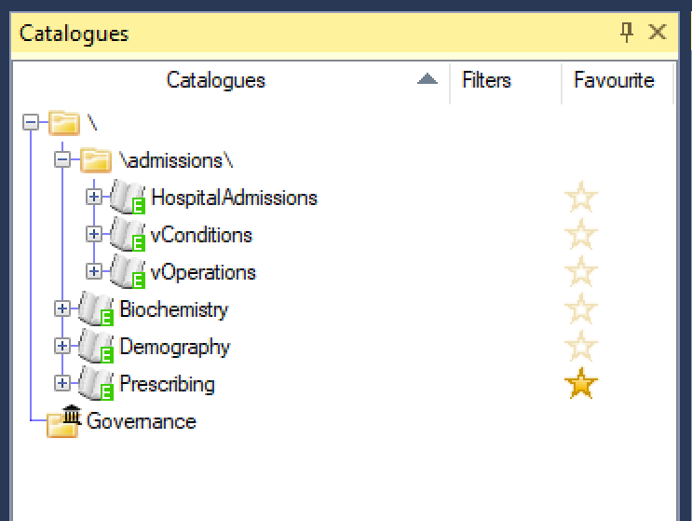
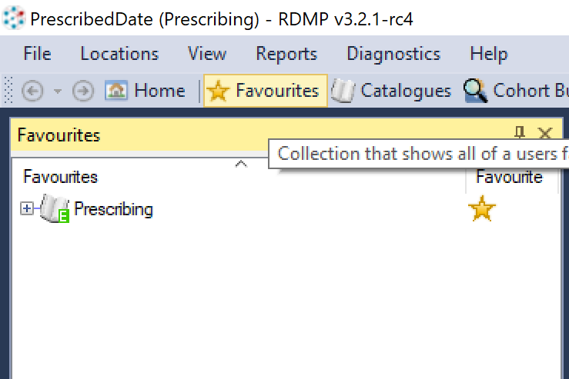
Find your work 2: Favourites
Find it in the “Favourites” list
Add something to your Favourites
This can contain object of various types (Catalogues, Projects, Cohorts, etc)

Slide 10
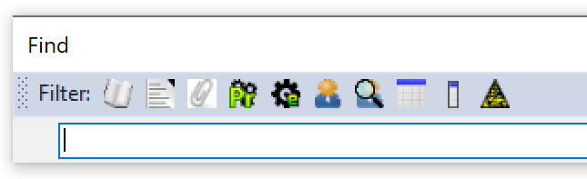
I’m lost!
Go Home!
This will always reset the windows layout
File -> Open… or Find… (Ctrl-O or Ctrl-F)
“Find” will find the object you want and pin it to the left, it will not alter the windows layout
“Open” will set up the layout in a meaningful manner to work with the chosen item

